Slide 1
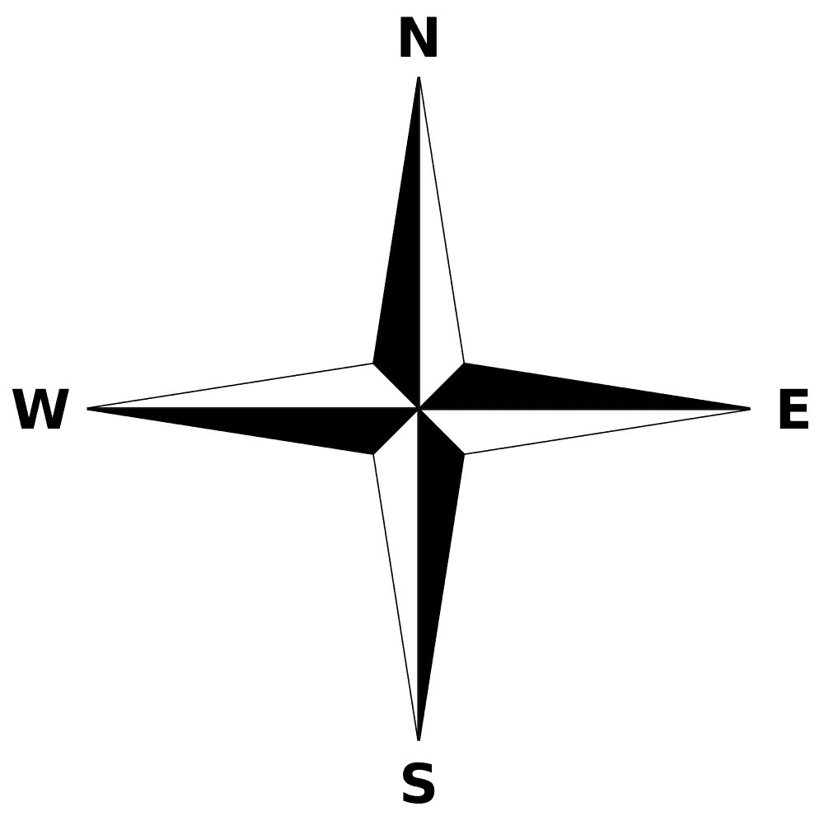
Red Rock Northern
Granite Creek
Summit
Red Rock
Refinery
Centennial Mills
Plastic Pellet Transfer
G.C.
Freight
Summit Cement
Champion Mine
Team Track
Interchange
Prairie Co-Op
Wagner & Son
Scrap
Lumber
1
Red Rock Yard
2
3
4
5
Shop
Yard Office

